Slide 1

MACHINE LEARNING
Machine Learning is a branch of Artificial Intelligence that leverages ( to use something that you already ) data to improve computer performance by giving machines the ability to learn.

Slide 2

Different Types of Methods
1: Based on human supervision:
a: Supervised Learning
b: Unsupervised Learning
c: Semi-supervised Learning
2: Based on learning ability:
a: Batch Learning
b: Online Learning
3: Based on Generalization Approach:
a: Instance based Learning
b: Model based Learning

Slide 3
Based on human supervision
SUPERVISED LEARNING . This learning algorithm take the data sample i.e. the training data and its associated output i.e. labels or responses with each data samples during the training process.
The main objective of supervised learning algorithms is to learn an association between input data samples and corresponding outputs after performing multiple training data instances.
For example, we have
x: Input variables and
Y: Output variable
Now, apply an algorithm to learn the mapping function from the input to output as follows −
Y=f(x)
Now, the main objective would be to approximate the mapping function so well that even when we have new input data (x), we can easily predict the output variable (Y) for that new input data
Examples of supervised machine learning algorithms includes Decision tree, Random Forest, KNN, Logistic Regression etc.

Slide 4
Unsupervised Learning
Unsupervised learning algorithms do not rely on labeled training data or a supervisor for guidance.
These algorithms are useful when we don't have pre-labeled training data and want to extract patterns from input data.
Common unsupervised learning algorithms include k-means clustering, hierarchical clustering, and principal component analysis (PCA).
Instead of predicting specific outputs, unsupervised learning focuses on understanding the underlying structure or organization of the data.
For example:
x: Input variables, then there would be no corresponding output variable and the algorithms need to discover the interesting pattern in data for learning.
Examples of unsupervised machine learning algorithms includes K-means clustering, K-nearest neighbors etc.
Based on the ML tasks, unsupervised learning algorithms can be divided into following broad classes −
1: Clustering 2 : Association 3 : Dimensionality Reduction

Slide 5
Semi-supervised Learning
It is neither fully supervised nor fully unsupervised.
These kinds of algorithms generally use small supervised learning component (small amount of pre-labeled annotated data ) and large unsupervised learning component(lots of unlabeled data )
2 APPROACHES
The first approach is to build the supervised model based amount of labeled and annotated data and then build the unsupervised model by applying the same to the large amounts of unlabeled data to get more labeled samples. And train the model.
The second we can first use the unsupervised methods to cluster similar data samples, annotate these groups and then use a combination of this information to train the model.

Slide 6
Reinforcement Learning
MAIN STEPS TO TRAIN:
Step 1 − First, we need to prepare an agent with some initial set of strategies.
Step 2 − Then observe the environment and its current state.
Step 3 − Next, select the optimal policy regards the current state of the environment and perform important action.
Step 4 − Now, the agent can get corresponding reward or penalty as per accordance with the action taken by it in previous step.
Step 5 − Now, we can update the strategies if it is required so.
Step 6 − At last, repeat steps 2-5 until the agent got to learn and adopt the optimal policies.

Slide 7
Based on learning ability
Batch Learning : main steps →
Step 1 − First, we need to collect all the training data for start training the model.
Step 2 − Now, start the training of model by providing whole training data in one go.
Step 3 − Next, stop learning/training process once you got satisfactory results/performance.
Step 4 − Finally, deploy this trained model into production. Here, it will predict the output for new data sample.
Online Learning : main steps →
Step 1 − First, we need to collect all the training data for starting training of the model.
Step 2 − Now, start the training of model by providing a mini-batch of training data to the algorithm.
Step 3 − Next, we need to provide the mini-batches of training data in multiple increments to the algorithm.
Step 4 − As it will not stop like batch learning hence after providing whole training data in mini-batches, provide new data samples also to it.
Step 5 − Finally, it will keep learning over a period of time based on the new data samples.

Slide 8
Data Loading for ML Projects
CSV data format is the most common format for ML data
but we need to take care about following major considerations while loading the same into our ML projects
File Header
he following are the two cases related to CSV file header which must be considered −
Case-I: When Data file is having a file header − It will automatically assign the names to each column of data if data file is having a file header.
Case-II: When Data file is not having a file header − We need to assign the names to each column of data manually if data file is not having a file header.
Comments : in CSV data file, comments are indicated by a hash (#) at the start of the line.
Delimiter:comma (,) character is the standard delimiter.
Quotes: double quotation (“ ”) mark is the default quote character.

Slide 9
Methods to Load CSV Data File
1 : Load CSV with Python Standard Library
Example
we are using the iris flower data set and it contains header and code is as
import csv
import numpy as np
path =r"C:\Users\DELL\Downloads\INTERN\IRIS.csv"
with open(path,'r') as f:
reader = csv.reader(f,delimiter=',')
headers = next(reader)
data = list(reader)
data = np.array(data).astype(float) #After loading the data file, we can convert it into NumPy array and use it for ML projects.
print(data.shape)
print(headers)
print(data[:3])
Out put ['sepal_length', 'sepal_width', 'petal_length', 'petal_width’]
(150, 4)
[ [5.1 3.5 1.4 0.2] [4.9 3. 1.4 0.2] [4.7 3.2 1.3 0.2] ]

Slide 10
Load CSV with NumPy
Example :we are using the Pima Indians Dataset having the data of diabetic patients.
It does not have any header
After loading the data file, we can convert it into NumPy array and use it for ML projects
from numpy import loadtxt
path = r"C:\pima-indians-diabetes.csv“
datapath= open(path, 'r’)
data = loadtxt(datapath, delimiter=",")
print(data.shape)
print(data[:3])
Output
(768, 9)
[ [ 6. 148. 72. 35. 0. 33.6 0.627 50. 1.]
[ 1. 85. 66. 29. 0. 26.6 0.351 31. 0.]
[ 8. 183. 64. 0. 0. 23.3 0.672 32. 1.] ]

Slide 11
Load CSV with Pandas
1 : IRIS DATA
from pandas import read_csv
path = r"C:Dell\download\INTERN\iris.csv“
data = read_csv(path)
print(data.shape)
print(data[:2])
Output: (150, 4)
sepal_length sepal_width petal_length petal_width
0 5.1 3.5 1.4 0.2
1 4.9 3.0 1.4 0.2 2 : DIABETES DATA from pandas import read_csv
path = r"C:\pima-indians-diabetes.csv"
headernames = ['preg', 'plas', 'pres', 'skin', 'test', 'mass', 'pedi', 'age', 'class’]
data = read_csv(path, names=headernames)
print(data.shape)
print(data[:2])
(768, 9)
preg plas pres skin test mass pedi age class
0 6 148 72 35 0 33.6 0.627 50 1
1 1 85 66 29 0 26.6 0.351 31 0

Slide 12
Understanding Data with Statistics
1:Looking at Raw Data
The very first recipe is for looking at your raw data. It is important to look at raw data because the insight we will get after looking at raw data will boost our chances to better pre-processing as well as handling of data for ML projects.
from pandas import read_csv
path = r"C:\pima-indians-diabetes.csv"
headernames = ['preg', 'plas', 'pres', 'skin', 'test', 'mass', 'pedi', 'age', 'class’]
data = read_csv(path, names=headernames)
print(data.head(50)) 2:Checking Dimensions of Data
It is always a good practice to know how much data, in terms of rows and columns, we are having for our ML project. The reasons behind is too less or too much data
from pandas import read_csv
path = r"C:\iris.csv“
data = read_csv(path)
print(data.shape)

Slide 13
3: Getting Each Attribute’s Data Type
It is another good practice to know data type of each attribute.
As sometimes we may need to convert one data type to another
from pandas import read_csv
path = r"C:\iris.csv"
data = read_csv(path)
print(data.dtypes)
Statistical Summary of Data
many times we need to review the summaries out of that shape of data.
It can be done with the help of describe() function of Pandas DataFrame that further provide the following 8 statistical properties of each & every data attribute
Count
Mean
Standard Deviation
Minimum Value
Maximum value
25%
Median i.e. 50%
75%

Slide 14
from pandas import read_csv
from pandas import set_option
path = r"C:\pima-indians-diabetes.csv"
names = ['preg', 'plas', 'pres', 'skin', 'test', 'mass', 'pedi', 'age', 'class’]
data = read_csv(path, names=names)
set_option('display.width', 100)
set_option(‘display.precision', 2)
print(data.shape)
print(data.describe())
Reviewing Class Distribution
Class distribution statistics is useful in classification problems where we need to know the balance of class values.
from pandas import read_csv
path = r"C:\pima-indians-diabetes.csv"
names = ['preg', 'plas', 'pres', 'skin', 'test', 'mass', 'pedi', 'age', 'class’]
data = read_csv(path, names=names)
count_class = data.groupby('class').size()
print(count_class)

Slide 15
Reviewing Correlation between Attributes relationship between two variables is called correlation In statistics, the most common method for calculating correlation is Pearson’s Correlation Coefficient Coefficient value = 1 − It represents full positive correlation between variables. Coefficient value = -1 − It represents full negative correlation between variables. Coefficient value = 0 − It represents no correlation at all between variables. . It is always good for us to review the pairwise correlations of the attributes because some machine learning algorithms such as linear regression and logistic regression will perform poorly if we have highly correlated attributes from pandas import read_csv
from pandas import set_option
path = r"C:\pima-indians-diabetes.csv“\
names = ['preg', 'plas', 'pres', 'skin', 'test', 'mass', 'pedi', 'age', 'class’]
data = read_csv(path, names=names)
set_option('display.width', 100)
set_option('precision', 2)
correlations = data.corr(method='pearson’)
print(correlations)

Slide 16
Reviewing Skew of Attribute Distribution
Skewness may be defined as the distribution that is assumed to be Gaussian but appears distorted or shifted in one direction or another, or either to the left or right
It is important because
. Presence of skewness in data requires the correction at data preparation stage so that we can get more accuracy from our model.
Most of the ML algorithms assumes that data has a Gaussian distribution i.e. either normal of bell curved data
from pandas
import read_csv
path = r"C:\pima-indians-diabetes.csv"
names = ['preg', 'plas', 'pres', 'skin', 'test', 'mass', 'pedi', 'age', 'class’]
data = read_csv(path, names=names)
print(data.skew())

Slide 17
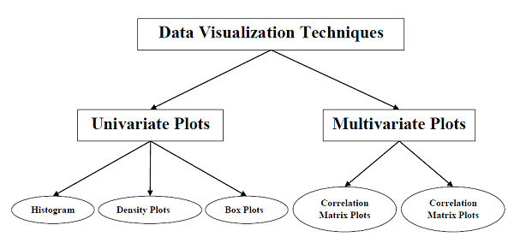
Understanding Data with Visualization
With the help of data visualization, we can see how the data looks like and what kind of correlation is held by the attributes of data.
Scatter Matrix Plot

Slide 18
Univariate Plots: Understanding Attributes Independently
With the help of univariate visualization, we can understand each attribute of our dataset independently
The following are some techniques
Histograms
Histograms group the data in bins and is the fastest way to get idea about the distribution of each attribute in dataset.
it provides us a count of the number of observations in each bin
From the shape of the bin, we can easily observe the distribution i.e. weather it is Gaussian, skewed or exponential
Histograms also help us to see possible outliers.
from matplotlib import pyplot
from pandas import read_csv
path = r"C:\pima-indians-diabetes.csv"
names = ['preg', 'plas', 'pres', 'skin', 'test', 'mass', 'pedi', 'age', 'class’]
data = read_csv(path, names=names)
data.hist() pyplot.show()

Slide 19
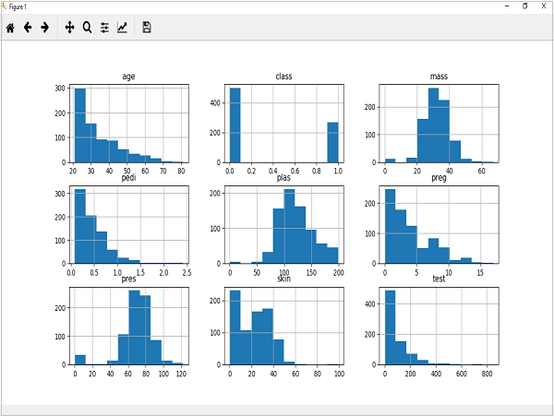
we can observe that perhaps age, pedi and test attribute may have exponential distribution while mass and plas have Gaussian distribution.

Slide 20
Density Plots
It is also like histogram but having a smooth curve drawn through the top of each bin.
from matplotlib import pyplot
from pandas import read_csv
path = r"C:\pima-indians-diabetes.csv"
names = ['preg', 'plas', 'pres', 'skin', 'test', 'mass', 'pedi', 'age', 'class’]
data = read_csv(path, names=names)
data.plot(kind='density', subplots=True, layout=(3,3), sharex=False)
pyplot.show()

Slide 21
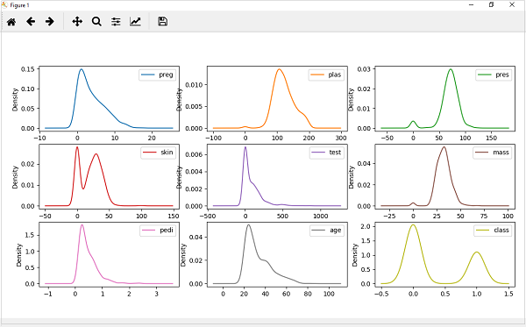
From the above output, the difference between Density plots and Histograms can be easily understood

Slide 22
Box and Whisker Plots
Box and Whisker plots, also called boxplots
characteristics of this technique −
It is univariate in nature and summarizes the distribution of each attribute.
It draws a line for the middle value i.e. for median.
It draws a box around the 25% and 75%.
It also draws whiskers which will give us an idea about the spread of the data.
The dots outside the whiskers signifies the outlier values. Outlier values would be 1.5 times greater than the size of the spread of the middle data.
from matplotlib import pyplot
from pandas import read_csv
path = r"C:\pima-indians-diabetes.csv“
names = ['preg', 'plas', 'pres', 'skin', 'test', 'mass', 'pedi', 'age', 'class’]
data = read_csv(path, names=names)
data.plot(kind='box', subplots=True, layout=(3,3), sharex=False,sharey=False)
pyplot.show()

Slide 23
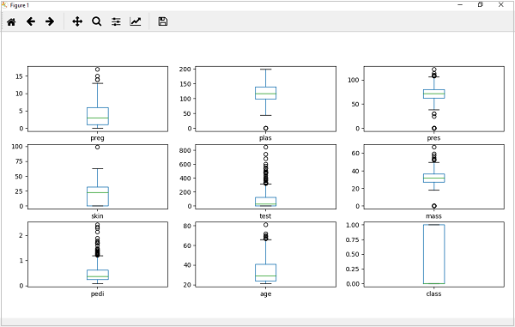
From the above plot of attribute’s distribution, it can be observed that age, test and skin appear skewed towards smaller values

Slide 24
Multivariate Plots: Interaction Among Multiple Variables
Another type of visualization . With the help of this, we can understand interaction between multiple attributes of our dataset. .
The following are some techniques.
Correlation Matrix Plot
Correlation is an indication about the changes between two variables. We can plot correlation matrix to show which variable is having a high or low correlation in respect to another variable.
from matplotlib import pyplot
from pandas import read_csv
import numpy
Path = r"C:\pima-indians-diabetes.csv"
names = ['preg', 'plas', 'pres', 'skin', 'test', 'mass', 'pedi', 'age', 'class’]
data = read_csv(Path, names=names)
correlations = data.corr()
fig = pyplot.figure()
ax = fig.add_subplot(111)
cax = ax.matshow(correlations, vmin=-1, vmax=1)
fig.colorbar(cax)
ticks = numpy.arange(0,9,1)

Slide 25
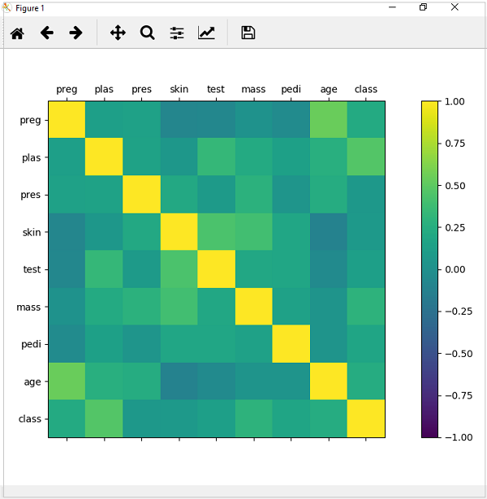
ax.set_xticks(ticks) ax.set_yticks(ticks) ax.set_xticklabels(names) ax.set_yticklabels(names) pyplot.show()
Observation each variable is positively correlated with each other.

Slide 26
Scatter Matrix Plot
Scatter plots shows how much one variable is affected by another or the relationship between them with the help of dots in two dimensions.
from matplotlib import pyplot
from pandas import read_csv
from pandas. plotting import scatter_matrix
path = r"C:\pima-indians-diabetes.csv"
names = ['preg', 'plas', 'pres', 'skin', 'test', 'mass', 'pedi', 'age', 'class’]
data = read_csv(path, names=names)
scatter_matrix(data)
pyplot.show()

Slide 27
